Slide 1
Comparative Analysis of Risk Measure Rankings:
Implications for Portfolio Optimization Under
Varying Risk Aversion
Date : 2025/05/08
Siam Miah
Ajeet Kumar Rai
Department of Applied Mathematics and Statistics, Stony Brook University
siam.miah@stonybrook.edu
ajeetkumar.rai@stonybrook.edu

Slide 2
INTRODUCTION
Extension of Fred Viole’s framework with additional downside risk measures for a broader risk analysis.
Newly included risk metrics: Max Drawdown, Value at Risk (VaR), Volatility, and Downside Beta.
Comprehensive downside risk coverage including EDoR, CDaR, CVaR, and LPM1–LPM4.
Enhanced correlation analysis by integrating Kendall’s correlation alongside Spearman’s.
Portfolio optimization using CVaR minimization techniques.
Evaluation of risk stability across different time windows to test robustness of risk rankings.

Slide 3
FRED VIOLE’S WORK - I
Developed an R-based pipeline to retrieve S&P 500 constituents and historical price data (2018–2025) from Wikipedia and financial sources.
Computed daily log returns for each stock to evaluate risk.
Calculated several downside risk measures, including:
Expected Regret of Drawdown (ERoD)
Conditional Drawdown at Risk (CDaR)
Conditional Value at Risk (CVaR)
Lower Partial Moments (LPM1–LPM4)
Ranked stocks based on each risk measure to compare risk perceptions across metrics.
Used Spearman’s rank correlation to examine consistency among risk rankings.

Slide 4
FRED VIOLE’S WORK - II
Found strong correlation among drawdown-based measures (e.g., ERoD vs. CDaR: 0.988).
Identified divergence at higher risk aversion levels, with lower correlation between drawdown and tail-focused measures (e.g., ERoD vs. LPM4: 0.675).
Confirmed Spearman's method as a suitable nonparametric approach for risk comparisons.
 | EDoR | CDaR | CVaR | LPM1 | LPM2 | LPM3 | LPM4
EDoR | 1.0000 | 0.9878 | 0.8815 | 0.7668 | 0.7505 | 0.7119 | 0.6747
CDaR | 0.9878 | 1.0000 | 0.8891 | 0.7719 | 0.7548 | 0.7139 | 0.6744
CVaR | 0.8815 | 0.8891 | 1.0000 | 0.8592 | 0.7984 | 0.7201 | 0.6584
LPM1 | 0.7668 | 0.7719 | 0.8592 | 1.0000 | 0.9516 | 0.8551 | 0.7786
LPM2 | 0.7505 | 0.7548 | 0.7984 | 0.9516 | 1.0000 | 0.9677 | 0.9194
LPM3 | 0.7119 | 0.7139 | 0.7201 | 0.8551 | 0.9677 | 1.0000 | 0.9872
LPM4 | 0.6747 | 0.6744 | 0.6584 | 0.7786 | 0.9194 | 0.9872 | 1.0000

Slide 5
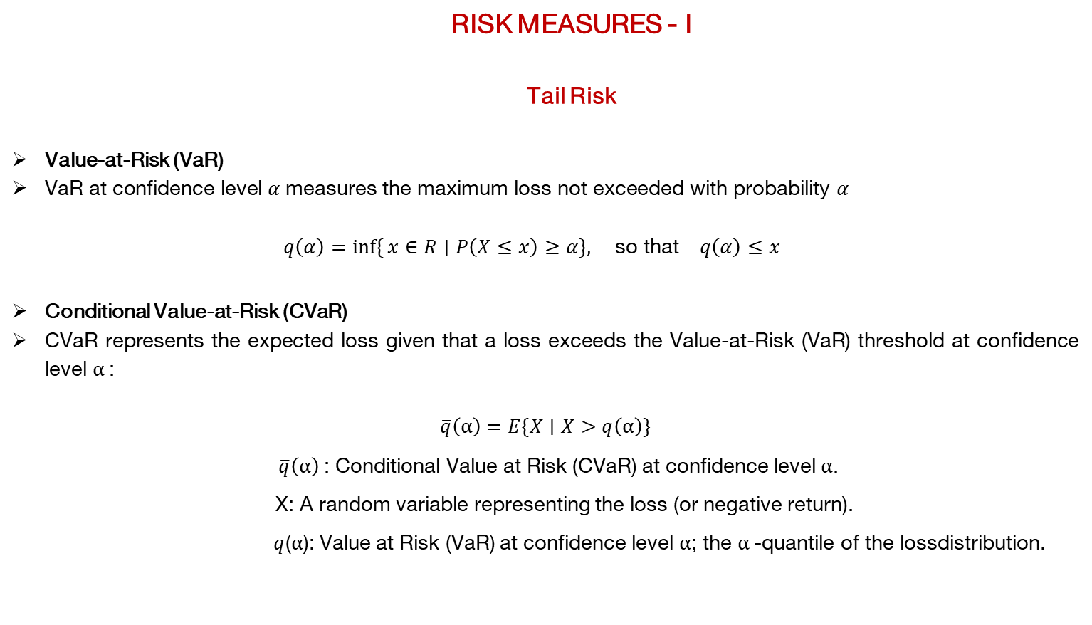
RISK MEASURES - I
Tail Risk
Value-at-Risk (VaR)
$\text{VaR} \text{at} \text{confidence} \text{level} α \text{measures} \text{the} \text{maximum} \text{loss} \text{not} \text{exceeded} \text{with} \text{probability}$ $α$
$$q\left(α\right)=\inf{\{}x∈R∣P\left(X≤x\right)≥α\}, \text{so} \text{that} q\left(α\right)≤x$$
Conditional Value-at-Risk (CVaR)
CVaR represents the expected loss given that a loss exceeds the Value-at-Risk (VaR) threshold at confidence level $α$:
$$\overline{q}\left(α\right)=E\{X∣X>q\left(α\right)\}$$
$\overline{q}\left(α\right)$: Conditional Value at Risk (CVaR) at confidence level $α$.
X: A random variable representing the loss (or negative return).
$q$($α$): Value at Risk (VaR) at confidence level $α$; the $α$-quantile of the lossdistribution.

Slide 6
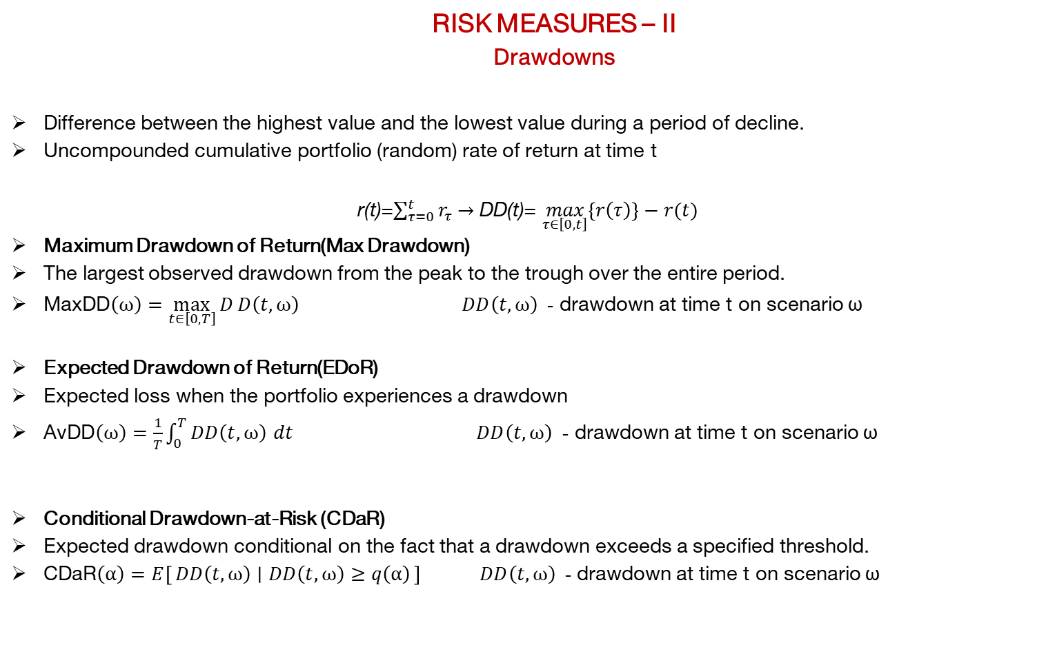
RISK MEASURES – II
Drawdowns
Difference between the highest value and the lowest value during a period of decline.
Uncompounded cumulative portfolio (random) rate of return at time t
r(t)=$\sum_{τ=0}^{t}{r_{τ}}$ $→$ DD(t)= $\max_{τ∈\left[0,t\right]}\left\{r\left(τ\right)\right\}−r(t)$
Maximum Drawdown of Return(Max Drawdown)
The largest observed drawdown from the peak to the trough over the entire period.
$\text{MaxDD}\left(ω\right)=\max_{t∈\left[0,T\right]}{D}D\left(t,ω\right)$ $DD\left(t,ω\right)$ - drawdown at time t on scenario ω
Expected Drawdown of Return(EDoR)
Expected loss when the portfolio experiences a drawdown
$\text{AvDD}\left(ω\right)=\frac{1}{T}\int_{0}^{T}{DD\left(t,ω\right)} dt$ $DD\left(t,ω\right)$ - drawdown at time t on scenario ω
Conditional Drawdown-at-Risk (CDaR)
Expected drawdown conditional on the fact that a drawdown exceeds a specified threshold.
$\text{CDaR}\left(α\right)=E\left[DD\left(t,ω\right) ∣ DD\left(t,ω\right)≥q\left(α\right)\right]$ $DD\left(t,ω\right)$ - drawdown at time t on scenario ω

Slide 7
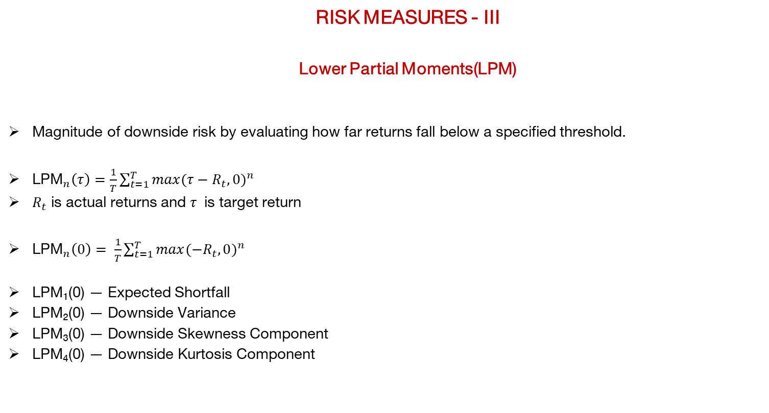
RISK MEASURES - III
Lower Partial Moments(LPM)
Magnitude of downside risk by evaluating how far returns fall below a specified threshold.
${\text{LPM}}_{n}\left(τ\right)=\frac{1}{T}\sum_{t=1}^{T}{{max(τ−R_{t},0)}^{n}}$
$R_{t}$ is actual returns and $τ$ is target return
${\text{LPM}}_{n}\left(0\right)= \frac{1}{T}\sum_{t=1}^{T}{{max(−R_{t},0)}^{n}}$
LPM₁(0) — Expected Shortfall
LPM₂(0) — Downside Variance
LPM₃(0) — Downside Skewness Component
LPM₄(0) — Downside Kurtosis Component

Slide 8
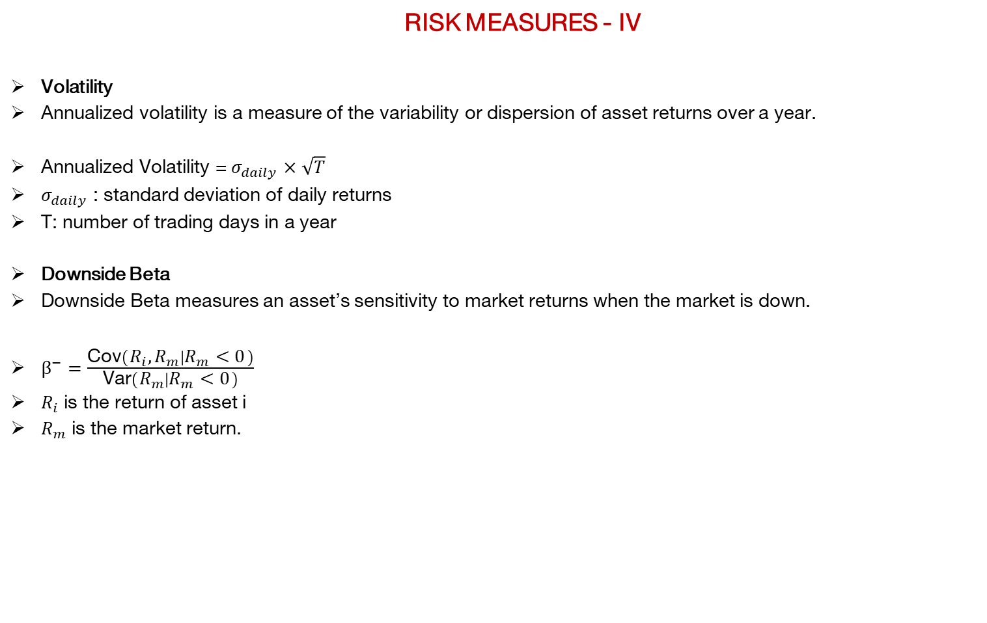
RISK MEASURES - IV
Volatility
Annualized volatility is a measure of the variability or dispersion of asset returns over a year.
Annualized Volatility =${ σ}_{daily}$ $×\sqrt{T}$
$σ_{daily}$ : standard deviation of daily returns
T: number of trading days in a year
Downside Beta
Downside Beta measures an asset’s sensitivity to market returns when the market is down.
$β^{−}=\frac{\text{Cov}\left(R_{i},R_{m} ∣ R_{m}<0\right)}{\text{Var}\left(R_{m} ∣ R_{m}<0\right)}$
$R_{i}$ is the return of asset i
$R_{m}$ is the market return.

Slide 9

CORRELATION - I
Describes the strength and direction of a relationship between two variables.
Pearson’s correlation:
$ρ_{X,Y}$=$\frac{Cov(X,Y)}{σ_{X}σ_{Y}}$
Cov(X,Y) is the covariance between variables X and Y and $σ_{X,}σ_{Y}$are the standard deviations of X and Y
Correlation ranges from −1 to +1
Correlation Type | Data Type | Captures
Pearson | Continuous (interval/ratio) | Linear relationship
Spearman | Ordinal or ranked | Monotonic relationship
Kendall’s Tau | Ordinal | Rank-order agreement
Distance Correlation | Any (numeric) | Any type of dependence

Slide 10

CORRELATION - II
Spearman’s Rank Correlation
Measures the strength and direction of the monotonic relationship between two ranked variables.
$ρ_{s}=1−\frac{6\sum{d_{i}^{2}}}{n\left(n^{2}−1\right)}$
$d_{i}^{2}$ is the square of difference between the ranks of corresponding values of the two variables.
n is the number of observations

Slide 11

CORRELATION - III
Kendall’s Tau Correlation
Kendall’s tau coefficient, denoted by τ, assesses the ordinal association between two measured quantities.
$τ=\frac{\left(C−D\right)}{\frac{1}{2}n\left(n−1\right)}$
C is the number of concordant pairs,
D is the number of discordant pairs,
n is the total number of observations.

Slide 12
CASE STUDY

Slide 13

CASE STUDY
Data Preparation
Retrieved S&P 500 stock list from Wikipedia.
Collected daily closing prices from Yahoo finance for all stocks and index
Time Period : Jan 2018 to Dec 2024.
Excluded 21 stocks due to excessive missing values.
Computed returns to normalize price changes:
$$r_{t}=\frac{P_{t}−P_{t−1}}{P_{t−1}}$$
$r_{t}$ is the return at time t, $P_{t}$ and $P_{t−1}$ is the price of the asset at time t and t-1.

Slide 14
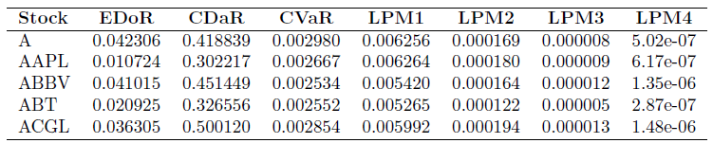
CASE STUDY
Risk Measure Computation
Set threshold Q to 0.2 and quantile level Q to 0.1.
Fred Viole risk : EDoR, CDaR, CVaR, LPM1, LPM2, LPM3, and LPM4
Added risk measures :Max Drawdown, VaR, Volatility, and Downside Beta

Slide 15
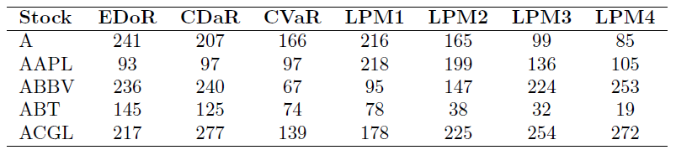
CASE STUDY
Rank Computation
Ranked each stock according to its risk measure in ascending order.
Higher rank represent higher risk

Slide 16
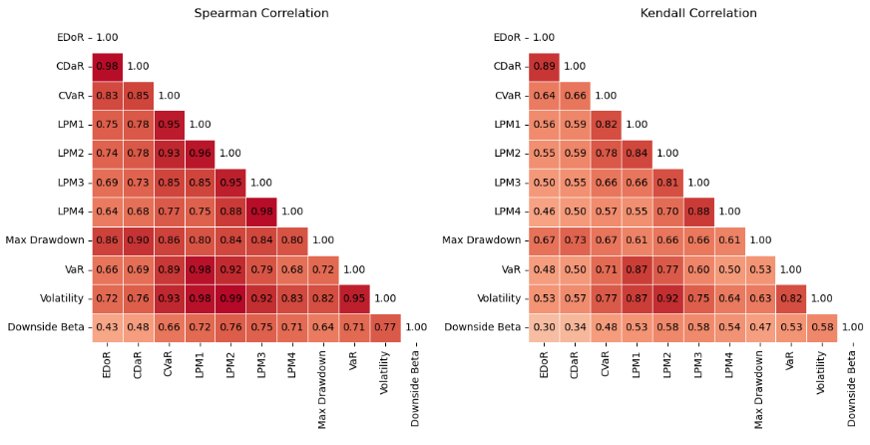
CASE STUDY
Risk measure analysis
Compared Spearman and Kendall correlations of risk measures.
Correlation of downside beta with other risk measures is lower.
Kendall’s correlation shows less correlation among risk measures as compared to Spearman’s.

Slide 17
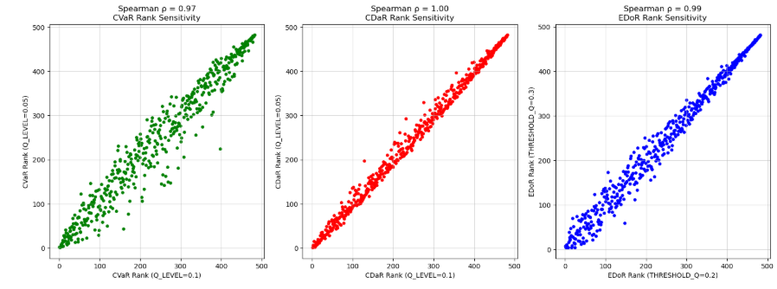
CASE STUDY
Risk Measure Sensitivity – I
Repeated risk analysis using different thresholds and quantile levels.
CVaR (Q = 0.1 vs. Q = 0.05): Shows slightly lower correlation (~0.97).
CDaR (Q = 0.1 vs. Q = 0.05): Values lie close to the diagonal in the plot with correlation 1.
EDoR (Q = 0.2 vs. Q = 0.3): Maintains near-perfect correlation with correlation (~0.99).

Slide 18
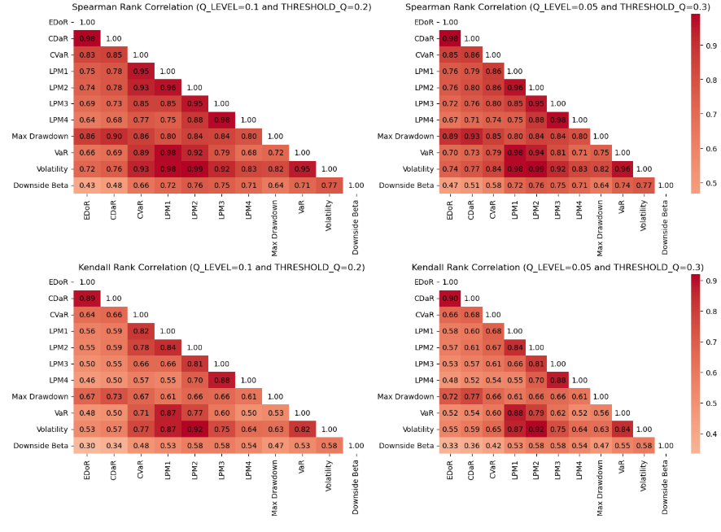
CASE STUDY
Risk Measure Sensitivity – II
Conducted analysis using both Spearman and Kendall correlation methods.
Kendall's correlation generally showed weaker relationships between risk measures.
Kendall correlations slightly increased for Q = 0.05 .

Slide 19
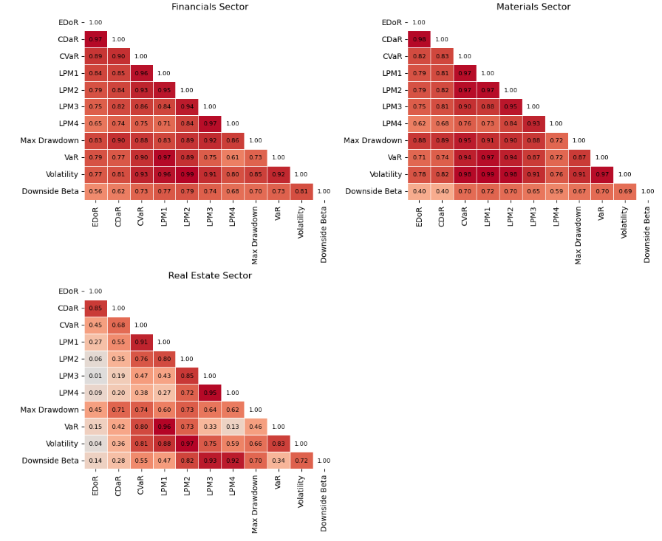
CASE STUDY
Sector Effects
Extended risk analysis to all 11 GICS sectors.
The Real Estate sector showed consistently low correlations across risk measures.

Slide 20
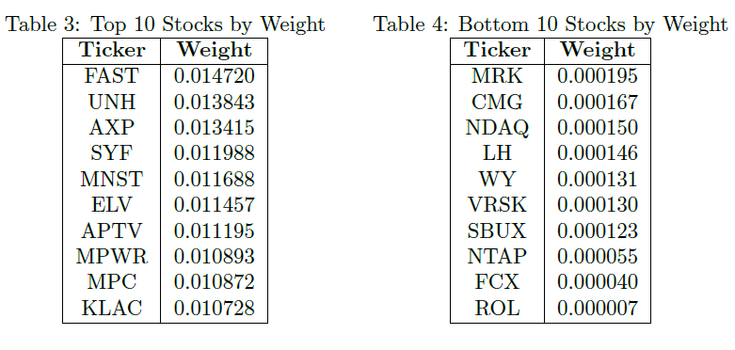
CASE STUDY
Portfolio Construction - I
Used 2018–2019 daily returns of S&P 500 stocks.
Calculate the weights of stocks using CVaR risk minimization.
Minimize:
cvar risk(0.90, matrix scenarios)
Constraint: == 1
linear(matrix budget)
Box:>= 0

Slide 21
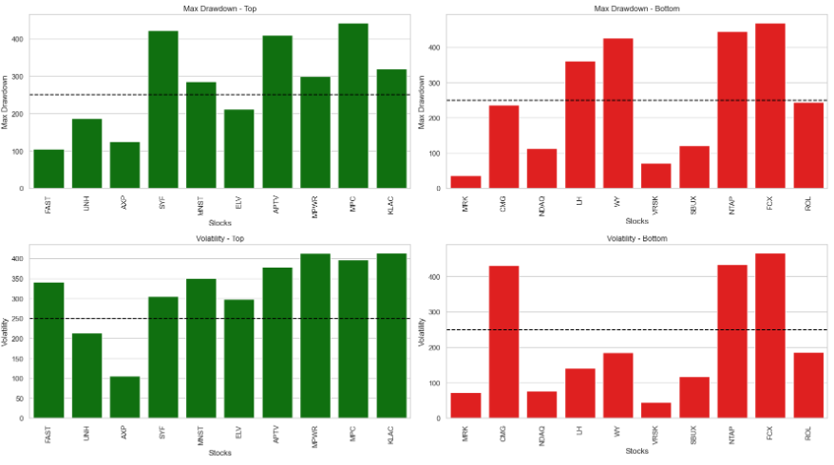
CASE STUDY
Portfolio Construction - II
Analyzed top and bottom 10 stocks based on CVaR-optimized weights
Assessed their Max Drawdown and Volatility over the test period
Top-weighted stocks showed higher rank.

Slide 22
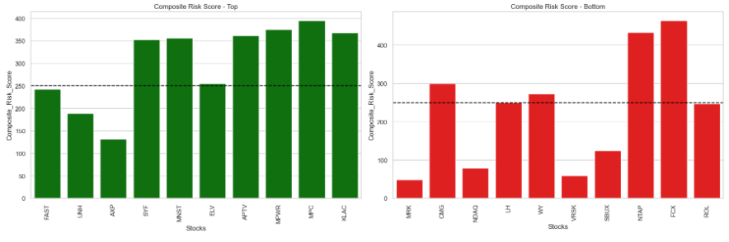
CASE STUDY
Portfolio Construction - III
Assigned weighted importance to 9 risk measures based on conservative risk preferences.
EDoR= 0, CVaR=Max Drawdown=0.2, Volatility= 0.15, LPM1= 0.05, LPM2= 0.1,LPM3 0.1, LPM4= 0.15
Downside Beta=0.05
Calculated a composite risk score per stock to capture overall downside risk exposure.

Slide 23
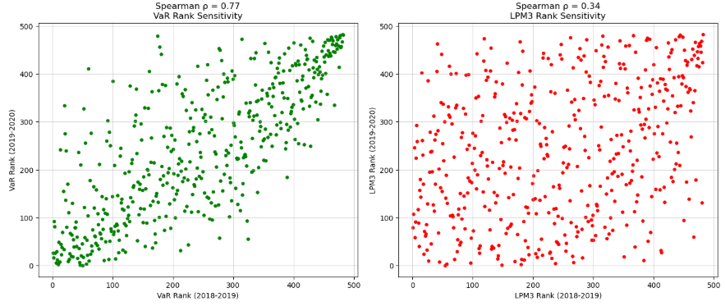
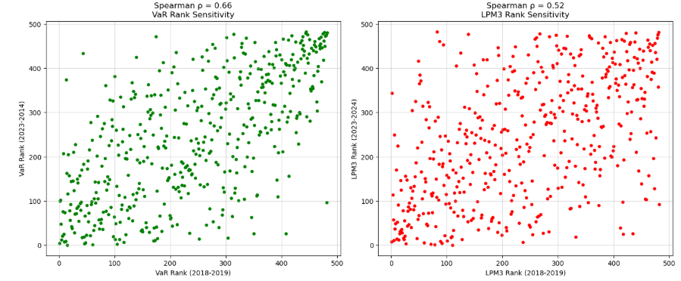
CASE STUDY
Time Stability and Predictive Power - I
Created datasets for six 2-year periods using a 1-year rolling window.
Computed risk measures ranked them in ascending order by risk score.
VaR and CVaR consistently captured downside risk effectively across time.
LPM3 was less reliable, showing weaker performance across periods.

Slide 24
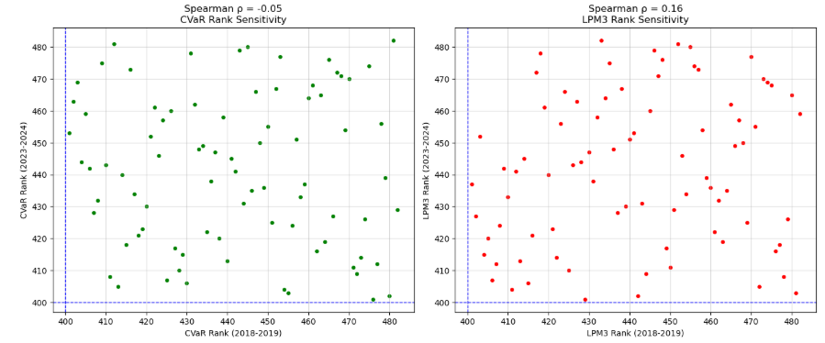
CASE STUDY
Time Stability and Predictive Power - II
Analyzed stocks with a rank higher than 400.
Rankings remained largely unchanged across the different periods.

Slide 25
CONCLUSION
Analyzed risk measures at both stock and sector levels and sensitivity across metrics.
Focused on minimizing CVaR risk in portfolio construction.
Explored portfolio composition changes under a conservative risk appetite profile.
Consistent rankings for top stocks across multiple rolling window periods.

Slide 26
REFERENCES
https://github.com/OVVO-Financial/Finance/blob/main/LPM_rank_cors.md
https://en.wikipedia.org/wiki/Risk_measure
https://en.wikipedia.org/wiki/Rank_correlation

Slide 27
THANK YOU !

